Slide 1
JAVA
Everybody in this world need to learn code, because it force people to think.
-Steve Jobs
JOB AND COURSE PROPOSER

Slide 2
OUTLINE
01
INTRODUCTION
02
DIAGRAMS
03
FEATURES
04
GUI DESCRIPTION

Slide 3
OUTLINE
05
DATABASE
06
TOOLS AND JAVA CONCEPTS
LIMITATIONS AND POSSIBLE FUTURE IMPROVEMENTS
07
08
CONCLUSION

Slide 4
INTRODUCTION
SHOWS AVAILABLE JOBS
SHOWS OFFERED COURSES
CAN CREATE OWN PROFILE
CHECK REQUIREMENTS
EASY AND RELIABLE FOR STUDENTS USE

Slide 5
DIAGRAMS
SYSTEM ARCHITECTURES
ER DIAGRAM
CLASS DIAGRAM
USE CASE DIAGRAM
STATECHART DIAGRAM

Slide 6
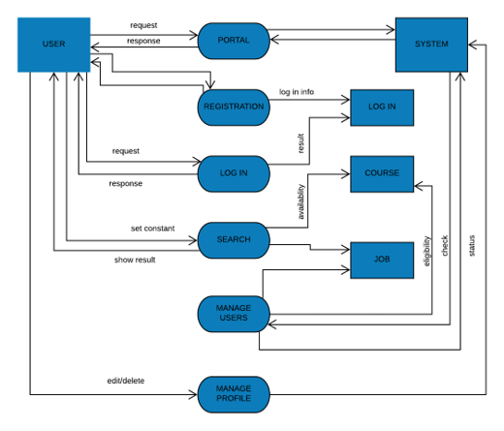
SYSTEM ARCHITECTURE

Slide 7
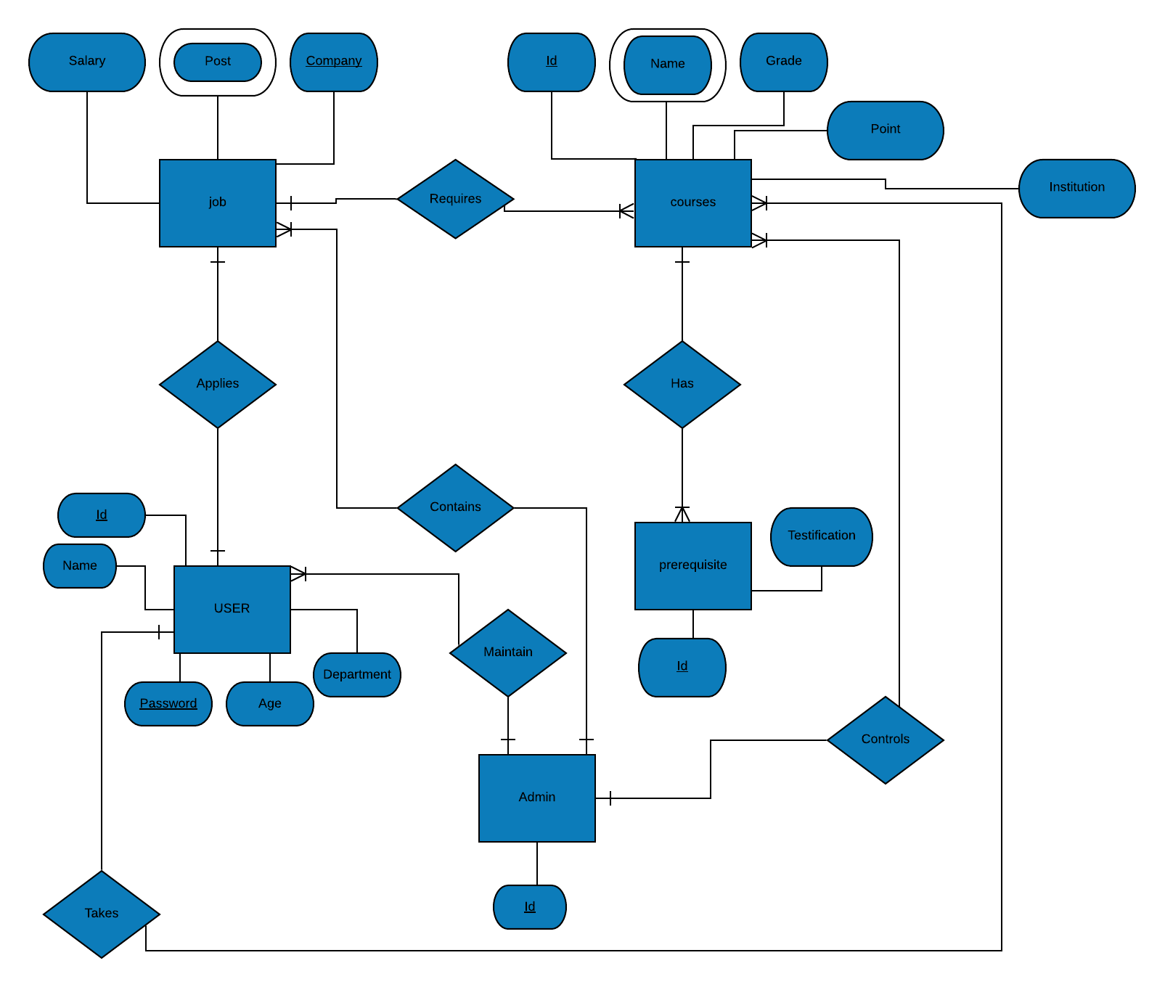
ER DIAGRAM

Slide 8
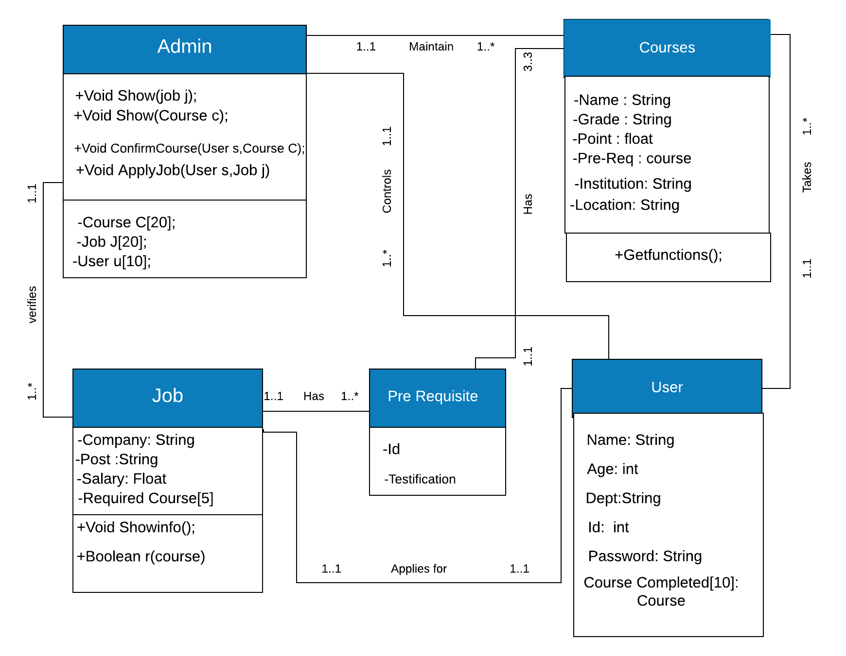
CLASS DIAGRAM

Slide 9
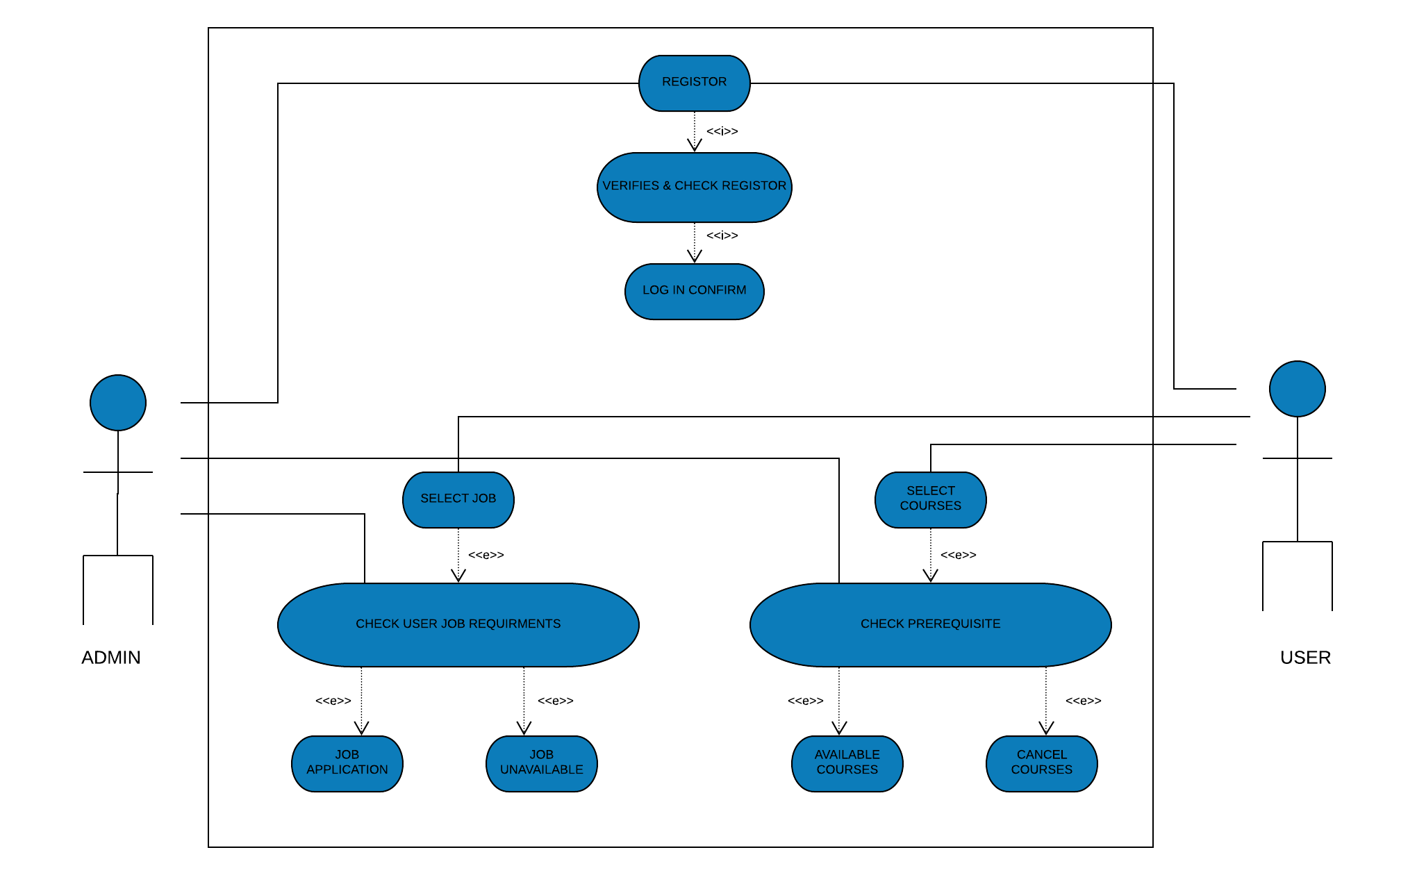
USE CASE DIAGRAM

Slide 10
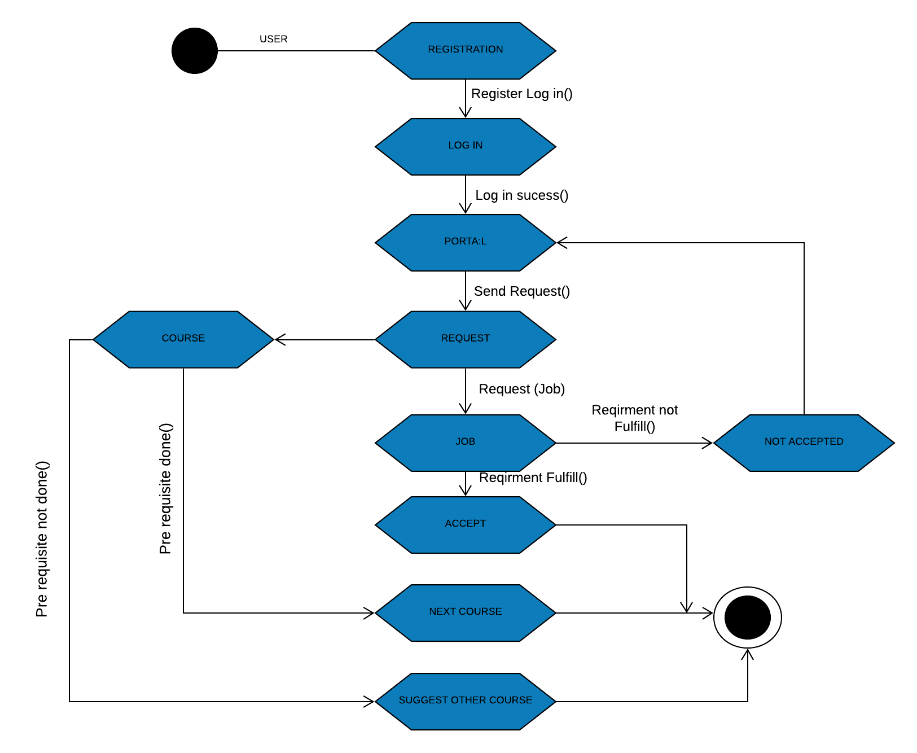
STATECHART DIAGRAM

Slide 11
FEATURES
USER PROFILE
1
4
REGISTRATION
4
ENROLL COURSES
2
5
SECURITY LOGIN
5
SELECTION OF PREFERANCES
3
6
AUTO
CHECKING
3
6

Slide 12
TOOLS USED
NETBEANS
DRAG AND DROP
JDBC CONNECTOR
XAMPP

Slide 13
JAVA CONCEPT USED
INHERITANCE
INTERFACE
EVENTS
EXCEPTION HANDLING
GRAPHICAL USER INTERFACE
JAVA DATABASSE CONNECTIVITY

Slide 14
ADVANTAGES
FIND COURSES
EASILY MANAGEABLE
RELEAT FROM EXTRA HASSELS
UPDATE PROFILE
FILTER RESULS

Slide 15
LIMITATIONS
INTERNET ACCESSIBILITY
REGULAR UPDATES
WORKING ON BIG DATA

Slide 16
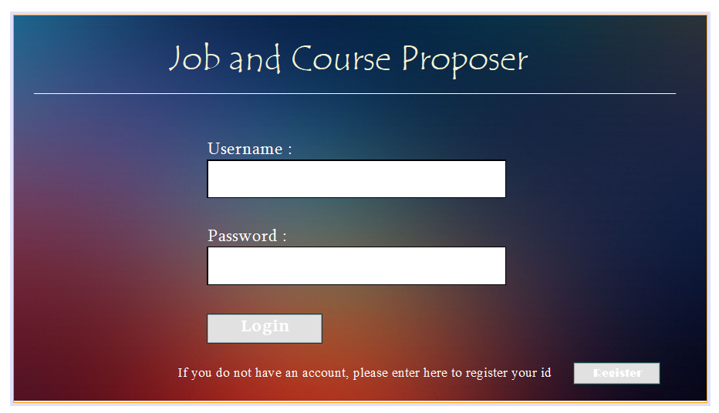
LOGIN PAGE
j
Login

Slide 17
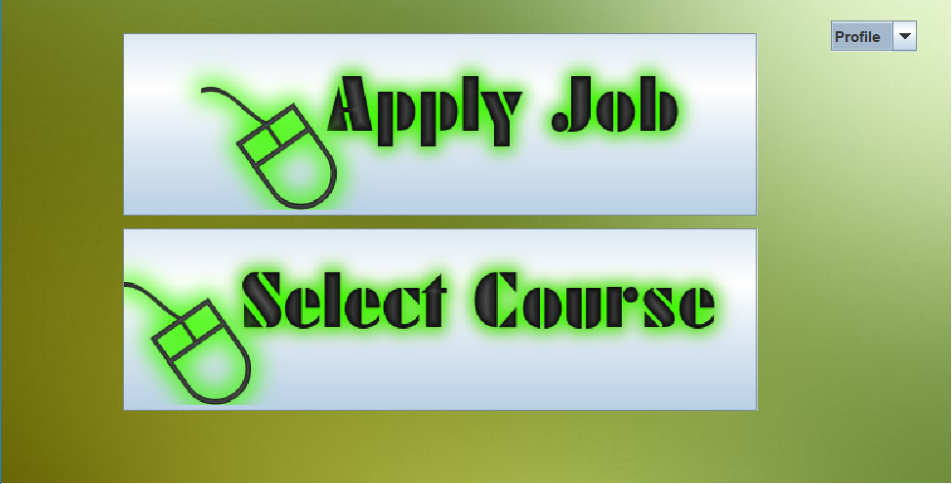
SELECTION PAGE
j
Login

Slide 18
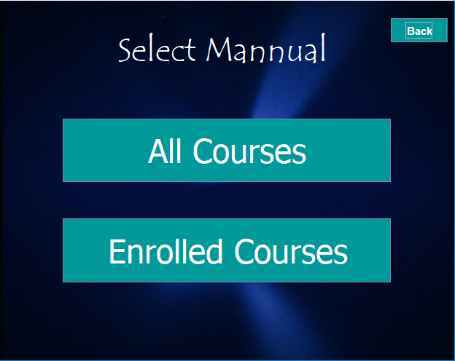
SELECTION PAGE
Content Here
You can simply impress your audience and add a unique zing and appeal to your Presentations. Easy to change colors, photos and Text.

Slide 19
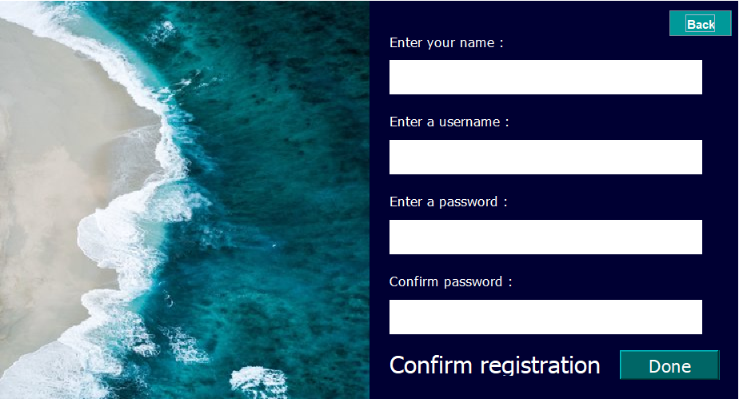
REGISTER
PAGE

Slide 20
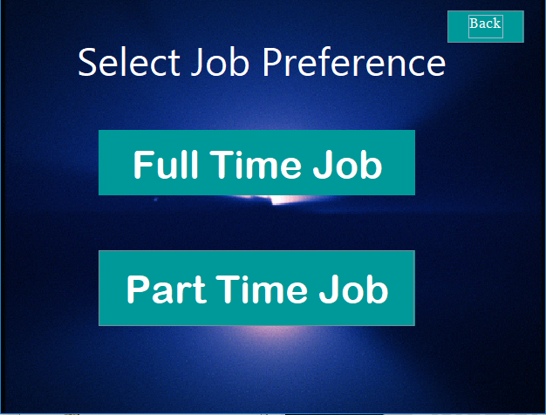
JOB OPTIONS

Slide 21
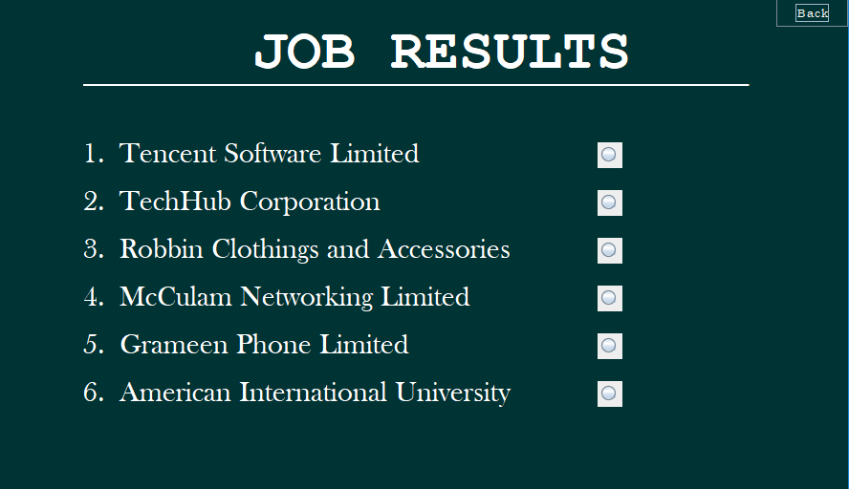
AVAILABLE JOB LIST
Content Here

Slide 22
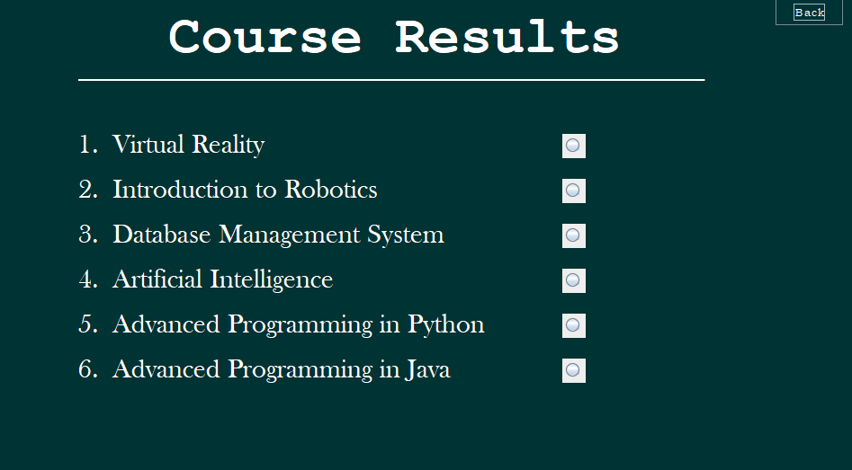
COURSE
LIST

Slide 23
CONCLUSION
USER FRIENDLY APPLICATION
EFFICIENCY LEVEL
SECURITY ACCESS
FUTURE EXPECTATIONS

Slide 24
Thank You
JAVA

